Slide 1
Lecture 5
Uniform Tube Modeling of Speech Production
Further Reading : Chapter-4 of book→Discrete-Time Speech Signal Processing: Principles and Practice by Thomas F. Quatieri

Slide 2
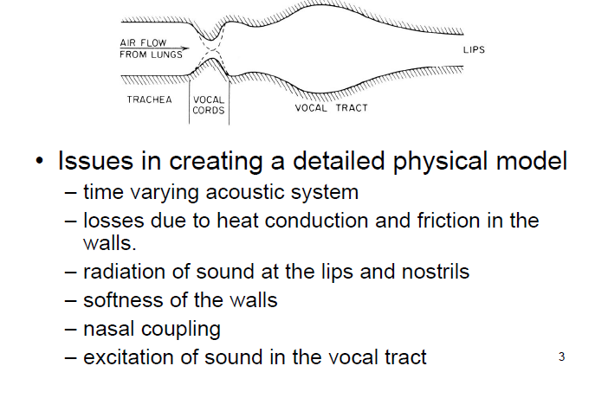
Sound in the Vocal Tract

Slide 3
Use of basic physics to formulate air flow equations for vocal tract
• Need to make simplifying assumptions about vocal tract shape and energy losses to solve air flow equations
• Some complicating factors:
time variation of the vocal tract shape ( we will look mainly at fixed shapes)
losses in flow at vocal tract walls (we will first assume no loss, then a simple model of loss)
softness of vocal tract walls (leads to sound absorption issues)
radiation of sound at lips (need to model how radiation occurs)
nasal coupling (complicates the tube models as it leads to multi-tube solutions)
excitation of sound in the vocal tract (need to worry about vocal source coupling to vocal tract as well as source-system interactions)

Slide 4
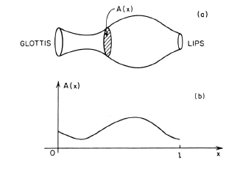
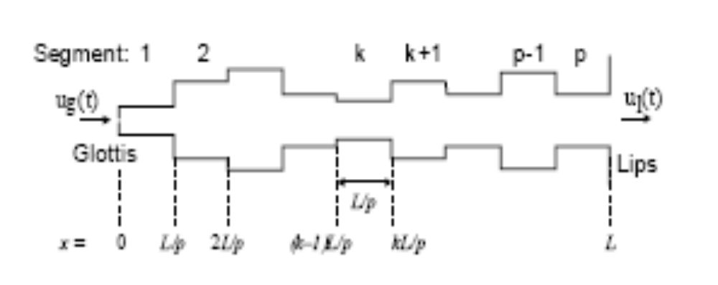

Slide 5

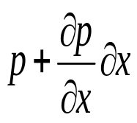
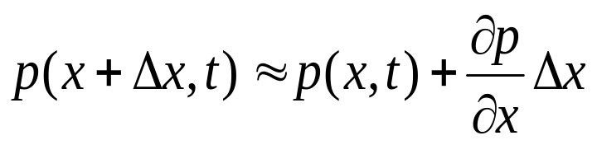
Wave equation
p
y
z
Infinite vibrating Wall
x
x
Pressure p(x, t) is a function of t and x and total pressure is
Particle velocity is v(x, t)
Density of air is ρ and also function of x and t

Slide 6
To derive wave equation three law of physics is used
Newton’s Second law of motion → this law predicts that a constant applied force produces a constant acceleration
The Gas law from thermodynamics →relates pressure volume and temperature under the adiabatic condition
Conservation of mass

Slide 7
Assumptions
Negligible friction of air particles in the cube i.e there is no shearing pressure due to horizontal movement→ the pressure on the cube is due to only two vertical faces
Cube is small enough so that the pressure change across the cube in horizontal dimension is first order

Slide 8
Assumption
The medium is homogeneous
The pressure change across a small distance can be linearized
There is no friction of air particle
The air particle velocity is small
Sound is adiabatic

Slide 9

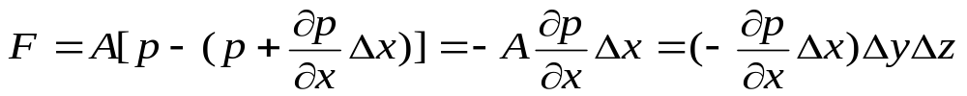


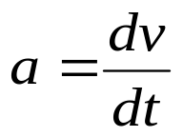
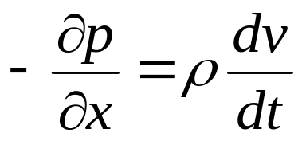
Net force on the chunk is
Assumed density in the cube is constant
From Newton’s Second Law of Motion
Acceleration of the cube air is
…..1

Slide 10
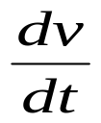
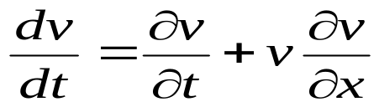
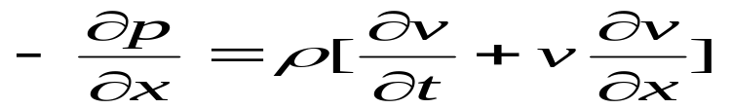


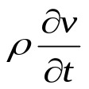
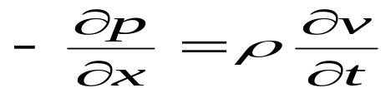
Is total derivative and v is a function of x and t
So true acceleration is
This is nonlinear equation in the variable v because the particle velocity v is multiply with
Is small relative to

Slide 11
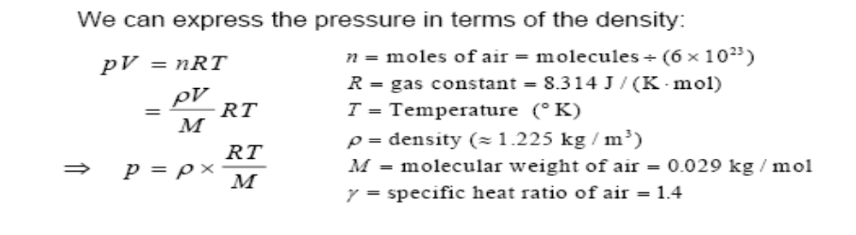
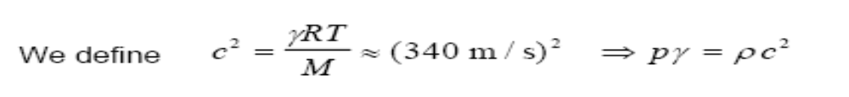
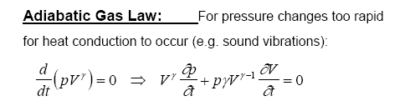
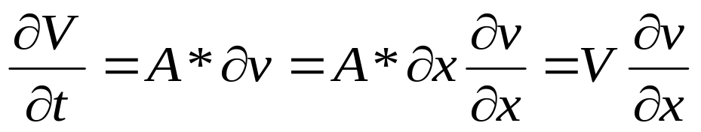

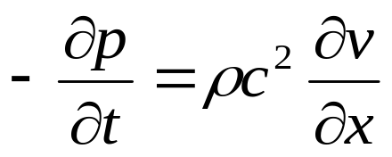
Gas Law
…..(2)

Slide 12
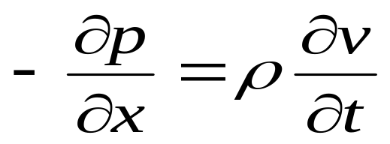
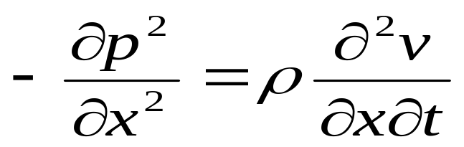
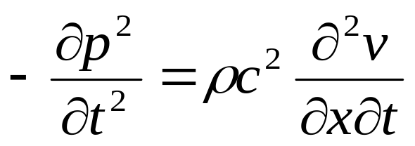
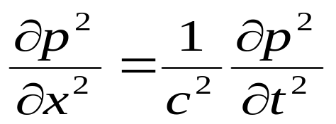
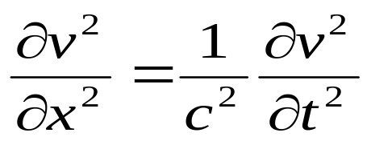
=>

Slide 13
Volume Velocity u(x,t) define as the rate of flow of air particle perpendicularly through a specific area.
u(x,t)= Av(x,t)

Slide 14
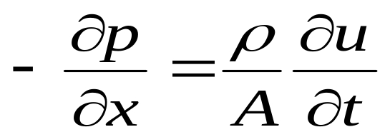
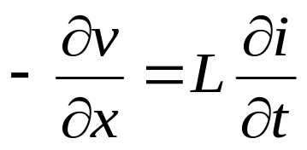
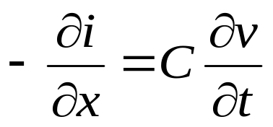
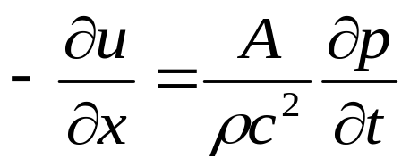







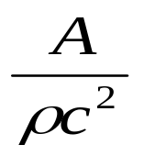
u(x,t) is the volume velocity
Acoustic
Electrical
Acoustic pressure
is the electrical voltage
is the electrical current
Acoustic volume velocity
electrical inductance
Acoustic inductance
electrical Capacitance
Acoustic Capacitance

Slide 15
Lecture-6
Uniform Tube Modeling of Speech Production
© CET, IIT KGP

Slide 17
Effects of Losses in VT
Several types of losses to be considered
Vibration of the tube walls
Viscous friction at the walls of the tube
Heat conduction through the walls of the tube
loss will change the frequency response of the tube

Slide 18
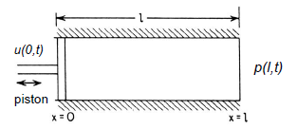
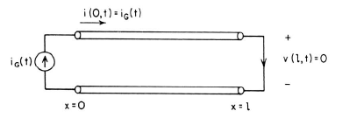
Uniform Lossless Tube
Assume uniform lossless tube => A(x,t)=A

Slide 19
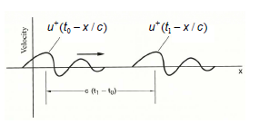
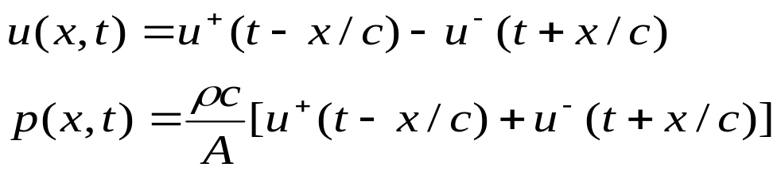






Traveling Wave Solution
Wave traveling forward
Wave traveling backward
Two boundary conditions:
(a) at the glottis gives:
(b) at the lips gives:
Since the differential equations are linear with constant coefficients, the solutions must be of the form where k⁺ and k⁻ represent the amplitude of forward and backward wave

Slide 20
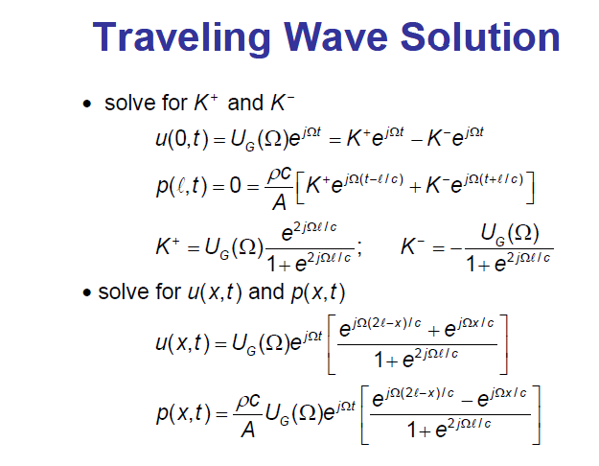

Slide 21
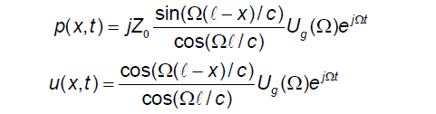

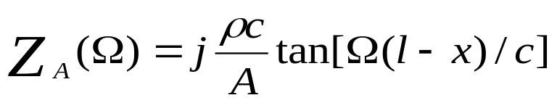
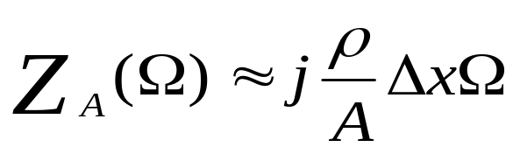
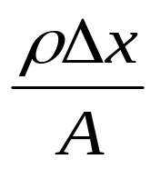
Where Z₀=
1
2
Acoustic impedance
If Δx is very small then from Taylor series expansion we get
→Can be thought as an acoustic mass

Slide 22
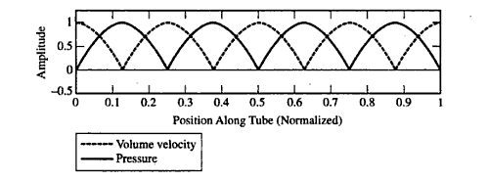
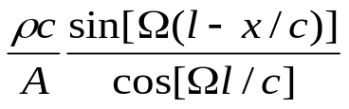
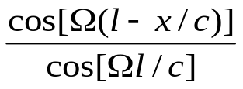
Envelope
Envelope

Slide 23
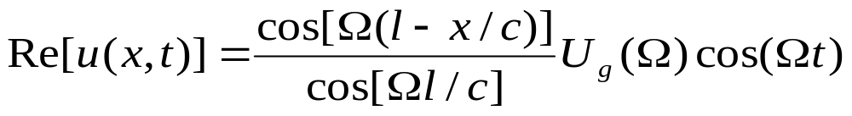
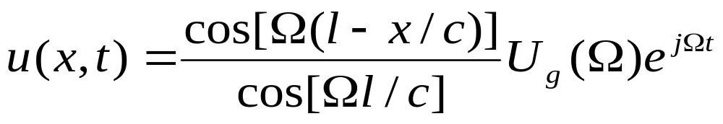
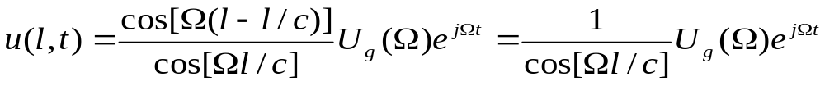
From equation (1) and (2)
At x=l

Slide 24
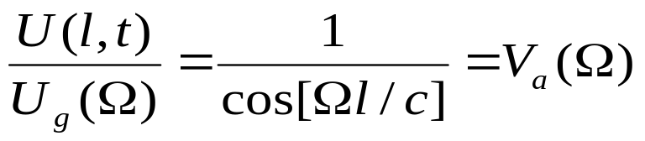
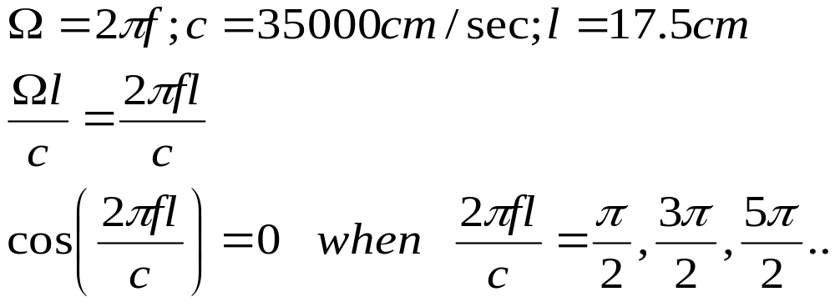
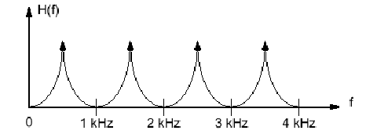
Frequency response of Uniform tube

Slide 25
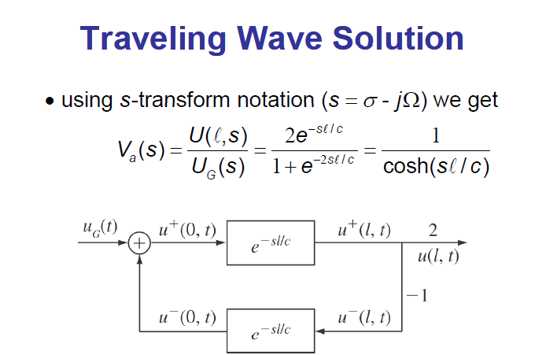

Slide 26
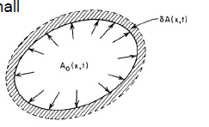
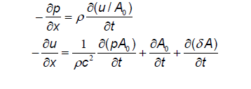
Wall vibrations
Assume walls are elastic => cross-sectional area of the tube will change with pressure in the tube
Assume walls are ‘locally’ reacting => A(x,t) ~ p(x,t)
Assume pressure variations are very small
A(x,t ) = A (x,t ) +δ A(x,t )
Neglecting second order terms in u/ A and pA , the wave equations become

Slide 27
Lecture-7
Uniform Tube Modeling of Speech Production (contd..)
© CET, IIT KGP

Slide 28
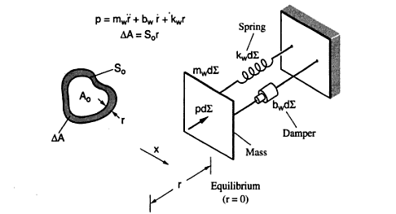

Slide 29



The differential equation relationship between area perturbation δ A(x,t ) and the pressure variation, p(x,t )
1
2
3

Slide 30


Under the steady state assumption that sound propagation has occurred long enough so that transient responses have died out and given that the three coupled equations (1,2,3) are linear and time invariant
Result in solution of the form

Slide 31


Using estimates for m_{W}, b_{W}, and k_{W} from measurements on body tissue, and with boundary condition at lips of p(l,t)=0, we get:
Length of the tube l=17.5 cm and 5 cm² in cross section
m_{w} =0.4gm/cm²,b_{w}=6500 dyne-sec/cm³, k_{w}=0
Observation
Complex poles with non-zero bandwidths
Slightly higher frequencies for resonances
Most effect at lower frequencies

Slide 32

Similarly account for effects of viscous friction and thermal conduction at the walls
• Increases bandwidth of complex poles
• Decreases resonance frequency (slightly)

Slide 33

Effects of Radiation at Lips
• We assumed p(l,t)=0 at the lips (the acoustical analog of a short circuit) => no pressure changes at the lips no matter how much the volume velocity changes at the lips
• In reality, vocal tract tube terminates with open lips, and sometimes open nostrils (for nasal consonants)
• This leads to two models for sound radiation at the lips
If the lip opening is small
Radiation from a spherical baffle
Radiation from a infinite plane baffle

Slide 34





This 'radiation load' is the equivalent of a parallel connection of a radiation resistance and a radiation inductance
Where
For infinite baffle, Flanagan has given the value
a is the radius of opening and c is the velocity of sound

Slide 35






At low frequencies,
short circuit termination which is the old solution
2. At mid-range frequencies
3. At higher frequencies

Slide 36


Overall Transfer Function

Slide 37
Frequency response of Uniform tube in no loss condition
Characterize by set of Formant Frequency Formant Band with is zero
Effects of viscous friction and thermal conduction at the walls
Effect due to the wall vibration

Slide 38
Effects of Radiation at Lips

Slide 39
VT Transfer Functions
The vocal tract can be characterized by a set of resonances (formants) that depend on the vocal tract area function-with shifts due to losses and radiation
The bandwidths of the two lowest resonances (F1 and F2) depend primarily on the vocal tract wall losses
The bandwidths of the highest resonances (F3, F4, ) depend primarily on viscous friction losses, thermal losses, and radiation losses

Slide 40
Nasal Coupling Effects
At the branching point
Sound pressure the same as at input of each tube
Volume velocity is the sum of the volume velocities at inputs to nasal and oral cavities
Closed oral cavity can trap energy at certain frequencies, preventing those frequencies from appearing in the nasal output => anti-resonances or zeros of the transfer function
Nasal resonances have broader bandwidths than non-nasal voiced sounds => due to greater viscous friction and thermal loss due to large surface area of the nasal cavity

Slide 41
Sound Excitation
1. Air flow from lungs is modulated by vocal cord vibration, resulting in a quasi-periodic pulse-like source
2. Air flow from lungs becomes turbulent as air passes through a constriction in the vocal tract, resulting in a noise-like source
3. Air flow builds up pressure behind a point of total closure in the vocal tract => the rapid release of this pressure, by removing the constriction, causes a transigent excitation (pop like like sound)

Slide 42


Vocal tract acts as a load on the vocal cord oscillator
Time varying glottal resistance and inductance-both functions of 1/AG(t) => when AG(t)=0 (total closure), impedance is infinite and volume velocity is zero

Slide 43








Boundary condition (lips)
TUBE
[Vocal track]
Z_{L}
Glottis
Lips

Slide 44






TUBE
[Vocal track]
Z_{L}
Glottis
Lips
_{Delay}
_{Delay}

Slide 45








Boundary condition (glottis)
TUBE
[Vocal track]
Z_{L}
Z_{g}
Glottis
Lips

Slide 46







Boundary condition (glottis)
TUBE
[Vocal track]
Z_{L}
Z_{g}
Glottis
Lips
Delay
Delay
If Z_{g}>>0 then R_{g}=1

Slide 47

Boundary condition (glottis)
TUBE
[Vocal track]
Z_{L}
Z_{g}
Glottis
Lips
Delay
Delay

Slide 48
Lecture-8

Slide 49

Speech Production System

Slide 50


Slide 51
Concatenated Tubes
Glottis
A₁
A₂
A₃
A₄
A₅
Lips
l₁
l₅
l₄
l₂
l₃

Slide 52








Wave Propagation at the Junction
l_{k}
k^{th} tube
(k+1)^{th} tube

Slide 53






Wave Propagation at the Junction
k^{th} tube
(k+1)^{th} tube

Slide 54




k^{th} tube
(k+1)^{th} tube

Slide 55

k^{th} tube
(k+1)^{th} tube

Slide 56




Slide 57



Slide 58




Define

Slide 59

−r_{k}
r_{k}
k^{th} tube
r_{k} > 0: A_{k+1}> A_{k}
(k+1)^{th} tube
r_{k} < 0: A_{k+1}< A_{k}

Slide 60





Delay
τ_{k}
Delay
τ_{k+1}
1+r_{k}
−r_{k}
r_{k}
Delay
τ_{k}
1−r_{k}
Delay
τ_{k+1}

Slide 61
Equal Spaced Tubes
Delay
τ_{k}
Delay
τ_{k+1}
1+r_{k}
−r_{k}
r_{k}
Delay
τ_{k}
1−r_{k}
Delay
τ_{k+1}
τ₁
τ₂
τ₃
τ₄
τ₅
τ₁= τ₂ = τ₃= ⋅⋅⋅ = τ
Δx
Δx
Δx
Δx
Δx

Slide 62
Equal Spaced Tubes
Let sampling period T₁= τ
Delay
τ_{k}
z⁻¹
Delay
τ_{k+1}
z⁻¹
1+r_{k}
−r_{k}
r_{k}
Delay
τ_{k}
1−r_{k}
z⁻¹
Delay
τ_{k+1}
z⁻¹
τ₁
τ₂
τ₃
τ₄
τ₅
τ₁= τ₂ = τ₃= ⋅⋅⋅ = τ
Δx
Δx
Δx
Δx
Δx

Slide 63


Vocal Tract Model
Let sampling period T₁= τ
Delay
τ_{k}
z⁻¹
Delay
τ_{k+1}
z⁻¹
1+r_{k}
−r_{k}
r_{k}
Delay
τ_{k}
1−r_{k}
z⁻¹
Delay
τ_{k+1}
z⁻¹
0.5(1+r_{G})
z⁻¹
1+r₁
z⁻¹
1+r₂
z⁻¹
1+r_{N−1}
z⁻¹
1+r_{L}
r_{G}
−r₁
r₁
−r₂
r₂
−r_{N−1}
r_{N−1}
−r_{L}
z⁻¹
1−r₁
z⁻¹
1−r₂
z⁻¹
1−r_{N−1}
z⁻¹

Slide 64


Vocal Tract Model
Let sampling period T₁= τ
Let sampling period T₂= 2τ
0.5(1+μ_{G})
z⁻¹
1+r₁
z⁻¹
1+r₂
z⁻¹
1+r_{N−1}
z⁻¹
1+r_{L}
z^{N}
z⁻²
z⁻²
z⁻²
z⁻²
z^{N/2}
r_{G}
−r₁
r₁
−r₂
r₂
−r_{N−1}
r_{N−1}
−r_{L}
1−r₁
1−r₂
1−r_{N−1}
0.5(1+r_{G})
1+r₁
1+r₂
1+r_{N−1}
1+r_{L}
z^{−N}
z^{−N/2}
r_{G}
−r₁
r₁
−r₂
r₂
−r_{N−1}
r_{N−1}
−r_{L}
z⁻²
1−r₁
1−r₂
1−r_{N−1}
z⁻¹
z⁻²
z⁻¹
z⁻²
z⁻¹
z⁻²
z⁻¹
0.5(1+μ_{G})
z^{−1/2}
1+r₁
z^{−1/2}
1+r₂
z^{−1/2}
1+r_{N−1}
z^{−1/2}
1+r_{L}
z⁻¹
z⁻¹
z⁻¹
z⁻¹
r_{G}
−r₁
r₁
−r₂
r₂
−r_{N−1}
r_{N−1}
−r_{L}
z⁻¹
1−r₁
1−r₂
1−r_{N−1}
z^{−1/2}
z⁻¹
z^{−1/2}
z⁻¹
z^{−1/2}
z⁻¹
z^{−1/2}

Slide 65




















Impulse Response
0.5(1+r_{G})
z^{−1/2}
1+r₁
z^{−1/2}
1+r₂
z^{−1/2}
1+r_{N−1}
z^{−1/2}
1+r_{L}
r_{G}
−r₁
r₁
−r₂
r₂
−r_{N−1}
r_{N−1}
−r_{L}
z^{−1/2}
1−r₁
z^{−1/2}
1−r₂
z^{−1/2}
1−r_{N−1}
z^{−1/2}

Slide 66





Impulse Response
0.5(1+r_{G})
z^{−1/2}
1+r₁
z^{−1/2}
1+r₂
z^{−1/2}
1+r_{N−1}
z^{−1/2}
1+r_{L}
r_{G}
−r₁
r₁
−r₂
r₂
−r_{N−1}
r_{N−1}
−r_{L}
z^{−1/2}
1−r₁
z^{−1/2}
1−r₂
z^{−1/2}
1−r_{N−1}
z^{−1/2}
Define

Slide 67













Impulse Response
0.5(1+r_{G})
1+r₁
1+r₂
1+r_{N−1}
1+r_{L}
(1+r_{N})
z^{−1/2}
z^{−1/2}
z^{−1/2}
z^{−1/2}
(−r_{N})
(r_{N})
r_{G}
−r₁
r₁
−r₂
r₂
−r_{N−1}
r_{N−1}
−r_{L}
z^{−1/2}
1−r₁
z^{−1/2}
1−r₂
z^{−1/2}
1−r_{N−1}
z^{−1/2}
(1−r_{N})
0
Define
Define

Slide 68



Impulse Response
0.5(1+r_{G})
1+r₁
1+r₂
1+r_{N−1}
1+r_{L}
(1+r_{N})
z^{−1/2}
z^{−1/2}
z^{−1/2}
z^{−1/2}
(−r_{N})
(r_{N})
r_{G}
−r₁
r₁
−r₂
r₂
−r_{N−1}
r_{N−1}
−r_{L}
z^{−1/2}
1−r₁
z^{−1/2}
1−r₂
z^{−1/2}
1−r_{N−1}
z^{−1/2}
(1−r_{N})
0

Slide 69


Impulse Response

Slide 70




Two-Tube Model

Slide 71

Two-Tube Model
one zero at origin
2nd order (2 poles)

Slide 72

N-Tube Model
one zero at origin
2nd order (2 poles)
All-pole Model
0.5(1+r_{G})
1+r₁
1+r₂
1+r_{N−1}
1+r_{L}
z^{−N/2}
r_{G}
−r₁
r₁
−r₂
r₂
−r_{N−1}
r_{N−1}
−r_{L}
z⁻¹
1−r₁
z⁻¹
1−r₂
z⁻¹
1−r_{N−1}
z⁻¹

Slide 73
Digital Models for Speech Signals
Area Function
(Reflection Coefficient)
Lossless
Tube
Model
u_{G}[n]
u_{L}[n]
Excitation
Source
Speech
Signal
Parameters
Linear System
V(z)
u_{G}[n]
u_{L}[n]

Slide 74

All-Pole Lattice Model
0 < r_{k} <1
−1 < r_{k} <0
Area Function
(Reflection Coefficient)
Lossless
Tube
Model
u_{G}[n]
u_{L}[n]

Slide 75


Direct Implementation
u_{G}[n]
G
u_{L}[n]
a₁
z⁻¹
z⁻¹
a₂
a_{N}
z⁻¹
Parameters
Linear System
V(z)
u_{G}[n]
u_{L}[n]

Slide 76













Poles of Vocal Tract Model
The roots of A(z) will be either real of occur in complex conjugate pairs.
Assume all poles are in conjugated pairs.

Slide 77












Poles of Vocal Tract Model
Assume all poles are in conjugated pairs.

Slide 78



Formant Frequency and Bandwidth
Formant Frequency (θ_{k})
3 dB
Bandwidth
b_{k}

Slide 79

Formant Frequency and Bandwidth
f₁
f₂
f₃
f₄

Slide 80

Formant Trajectory

Slide 81








Cascade Implementation
G
Each Stage represents one formant frequency
and its corresponding bandwidth.
z⁻¹
z⁻¹
z⁻¹
z⁻¹
z⁻¹
z⁻¹

Slide 82



Speech Production Model
A_{v}
Impulse
Train
Generator
Glottal
Pulse
G(z)
Vocal Track
Parameters
Voiced Sound
u_{G}[n]
Vocal Track
V(z)
u_{L}[n]
Lip
Radiation
R(z)
p_{L}[n]
Unvoiced Sound
Random
Noise
Generator
A_{N}

Slide 83



Radiation
Vocal Track
Parameters
u_{G}[n]
Vocal Track
V(z)
u_{L}[n]
Lip
Radiation
R(z)
p_{L}[n]
A High-Pass Filter

Slide 84



Excitation
Impulse
Train
Generator
Glottal
Pulse
G(z)
A_{v}
u_{G}[n]

Slide 85
Speech Production Model
H(z)=G(z)V(z)R(z)
A_{v}
Impulse
Train
Generator
Glottal
Pulse
G(z)
Vocal Track
Parameters
Voiced Sound
u_{G}[n]
Vocal Track
V(z)
u_{L}[n]
Lip
Radiation
R(z)
p_{L}[n]
Unvoiced Sound
Random
Noise
Generator
H(z)
A_{N}

Slide 86

Speech Production Model
H(z)=G(z)V(z)R(z)

Slide 87

Linear Prediction Model
H(z)=G(z)V(z)R(z)

